Slide 1
#JS İzmir
OOP JS & ES6

Slide 2
Agenda
JS Fundamentals
ES6 Features
OOP or OLOO in JS
Q & A

Slide 3

Functional Programming
Functional programming is the process of building software by composing pure functions, avoiding shared state, mutable data, and side-effects.
Functional programming is declarative rather than imperative, and application state flows through pure functions. Contrast with object-oriented programming, where application state is usually shared and collocated with methods in objects.
Notes:
Bir programming paradigm olarak gecer OOP Imperative, Functional Declarative.
Pure function kullanarak, shared state mutable data ve side effectten kacinarak yazilim gelistirme yontemidir.
Object oriented Programlama yapisinda Method tanimlarinin nesneler uzerinde tanimlanir ve uygulama state’nin genel anlamda objeler arasinda paylasilir.
Functional programlamada bu sekilde bir yontem zorunlulugu yoktur.
Impreative yapidan ziyade Declarative bir yapiya sahiptir.

Slide 4

JS Fundamentals

Slide 5
JavaScript Types & Type Coercion
JS Fundamentals
In JavaScript there are 5 different data types that can contain values:
string
number
boolean
object
Function
Symbol – ES6
There are 6 types of objects:
Object
Date
Array
String
Number
Boolean
And 2 data types that cannot contain values:
null
undefined
Notes:
Numbers
Only one number type
No integers
64-bit floating point
IEEE-754 aka “Double”
Does not map well to common understanding of arithmetic:
0.1 + 0.2 = 0.30000000000000004
ES6 - Number.MAX_SAFE_INTEGER - 9007199254740991
https://stackblitz.com/edit/javascript-types-and-conversion?file=index.ts
typeof new String() is object whereas typeof “” is string

Slide 6
JavaScript Types & Type Coercion
JS Fundamentals
You can use the typeof operator to find the data type of a JavaScript variable.
When JavaScript tries to operate on a "wrong" data type, it will try to convert the value to a "right" type.
Type coercion is the automatic or implicit conversion of values from one data type to another (such as strings to numbers).
Type conversion is similar to type coercion because they both convert values from one data type to another with one key difference — type coercion is implicit whereas type conversion can be either implicit or explicit.
Notes:
!right is not hand side, to a correct type (not all the time.)

Slide 7
Type Conversion Table
JS Fundamentals
Original Value | Converted to Number | Converted to String | Converted to Boolean
false | 0 | "false" | false
true | 1 | "true" | true
0 | 0 | "0" | false
1 | 1 | "1" | true
"0" | 0 | "0" | true
"000" | 0 | "000" | true
"1" | 1 | "1" | true
NaN | NaN | "NaN" | false
Infinity | Infinity | "Infinity" | true
-Infinity | -Infinity | "-Infinity" | true
"" | 0 | "" | false
"20" | 20 | "20" | true
"twenty" | NaN | "twenty" | true
[ ] | 0 | "" | true
[20] | 20 | "20" | true
[10,20] | NaN | "10,20" | true
["twenty"] | NaN | "twenty" | true
["ten","twenty"] | NaN | "ten,twenty" | true
function(){} | NaN | "function(){}" | true
{ } | NaN | "[object Object]" | true
null | 0 | "null" | false
undefined | NaN | "undefined" | false
Notes:
* Red values are most of the time not expected.

Slide 8
Truthy & Falsy
JS Fundamentals
Falsy Values
false
null
undefined
Empty string (‘’)
0
NAN
All other values including objects are truthy.

Slide 9
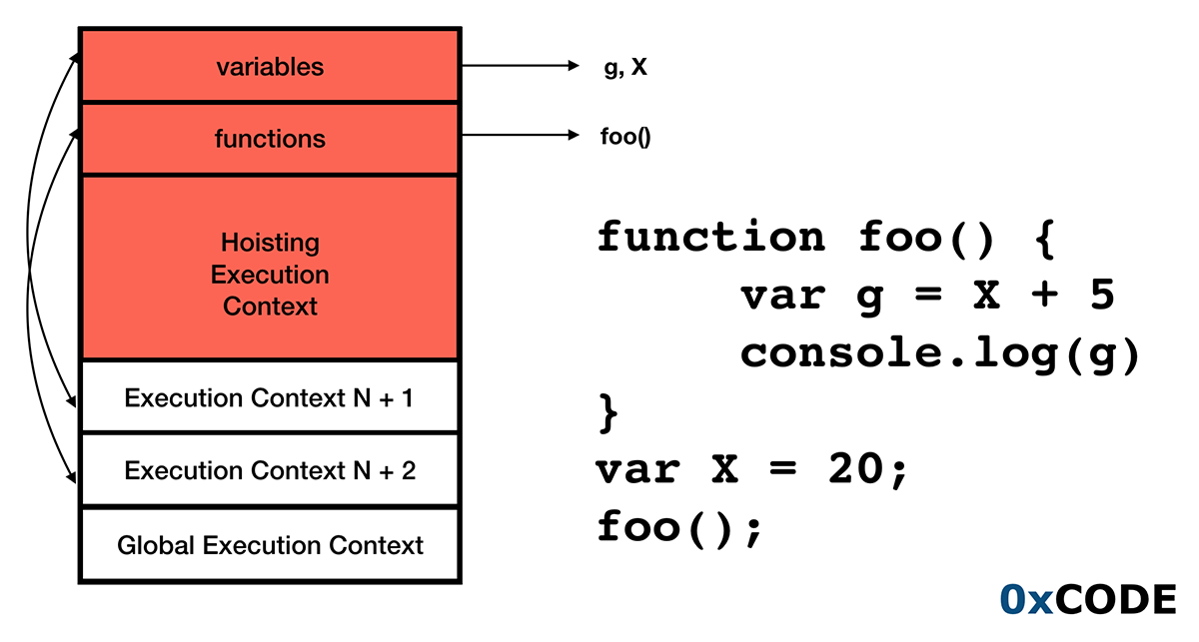
Hoisting
JS Fundamentals
A variable can be declared after it has been used. In other words; a variable can be used before it has been declared. This is being called `hoisting`.
Notes:
Variables and constants declared with the keywords ‘let’ or ‘const’ are not hoisted.
Functions can be called before declaration. One with declared with function not function variables.

Slide 10
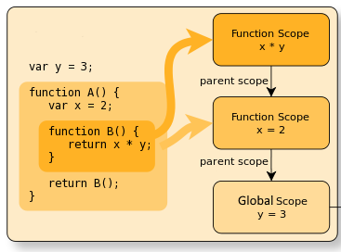
Variable Scope
JS Fundamentals
A scope in JavaScript defines what variables you have access to.
Variables defined inside a function are in local scope while variables defined outside of a function are in the global scope.
Each function when invoked creates a new scope.
Function Scope – Variables declared in function can be accessed through out that function block, but it is not accessible outside of the function.
Block Scope – Variables defined with the keywords let or const are accessible though out of the {block}.
Notes:
* That is true for web browsers, for node js you have to define like this.
global.PI = 3.14

Slide 11
Lexical Scope & Closure (1)
JS Fundamentals
Lexical Scope means that in a nested group of functions, the inner functions have access to the variables and other resources of their parent scope.
This means that the child functions are lexically bound to the execution context of their parents.
function grandfather() {
var name = 'Habib';
// likes is not accessible here
function parent() {
//name is accessible here
// likes is not accessible here
function child() {
// Innermost level of the scope chain
// name is also accessible here
var likes = 'Coding';
}
}
}

Slide 12
Lexical Scope & Closure (2)
JS Fundamentals
A closure gives you access to an outer function’s scope from an inner function. Closures are created every time a function is created, at function creation time.
A closure can not only access the variables defined in its outer function but also the arguments of the outer function.
A closure can also access the variables of its outer function even after the function has returned.
Notes:
Give brief about Module Pattern, private public methods etc.
https://stackblitz.com/edit/javascript-func-closure?file=index.ts

Slide 13
New Features
{ _ }
ECMAScript 6

Slide 14
Let + const
ECMAScript 6
Block-scoped variables (and constants) without hoisting.
Constants (also known as "immutable variables"), i.e., variables which cannot be re-assigned new content.
Notice: this only makes the variable itself immutable, not its assigned content (for instance, in case the content is an object, this means the object itself can still be altered).
Notes:
http://localhost:8000/es6/01-let-and-const

Slide 15
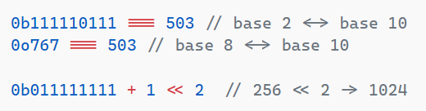
Binary & Octal Literal
ECMAScript 6
Direct support for safe binary and octal literals.
Notes:
http://localhost:8000/es6/01-let-and-const

Slide 16

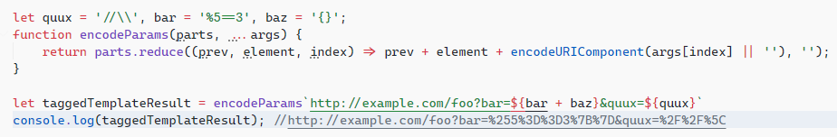
Template Literals
ECMAScript 6
String Interpolation - Intuitive expression interpolation for single-line and multi-line strings.
Tagged templates - Tags allow you to parse template literals with a function.
Notes:
http://localhost:8000/es6/01-let-and-const
One can access raw strings of parts via parts.raw[index] this will give you the exact string
F.E – `foo\\${bar}`
parts[0] will be ‘foo\’ but parts.raw[0] will be ‘foo\\’

Slide 17

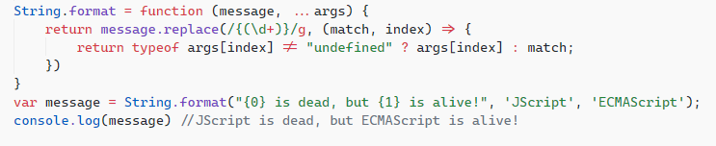

Extended Parameter Handling
ECMAScript 6
Default Parameters - default values for function parameters
Rest Parameters – Allows you to capture parameter passed to a function other than named arguments.
Spread Operator - Spreading of elements of an iterable collection (like an array or even a string) into both literal elements and individual function parameters.
Notes:
Spread is looks like a rest operator. spread 'expands' an array into its elements, while rest collects multiple elements and 'condenses' them into a single element.
Copy an array […originalArray]
Concatenating arrays […arr1, arr2]
Spread elements to function arguments
Combine objects into one {…obj1, …obj2} - ECMAScript 2018 (ECMA-262)

Slide 18
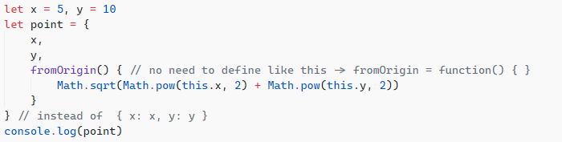
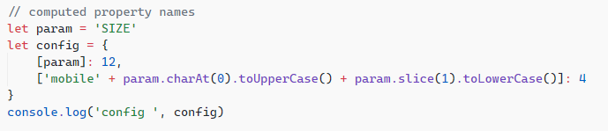
Enhanced object literals
ECMAScript 6
Property Shorthand - Shorter syntax for common object property definition idiom.
Method Properties - Support for method notation in object property definitions, for both regular functions and generator functions.
Computed Property Names - Support for computed names in object property definitions.

Slide 19
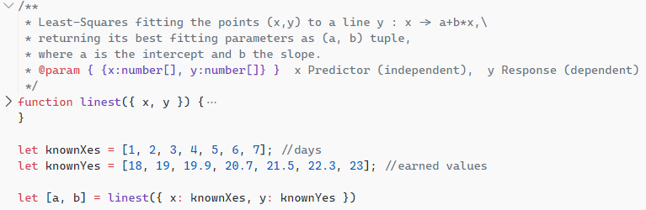
Destructuring
ECMAScript 6
Array Matching - Intuitive and flexible destructuring of Arrays into individual variables during assignment.
Object Matching, Shorthand Notation, Deep Matching - Support for method notation in object property definitions, for both regular functions and generator functions.
Object and Array destructuring can be done with default values.
Function arguments also can be form of destructuring.
Notes:
Object destructuring
Shorthand var { op, lhs, rhs } = getASTNode()
Deep var { op: a, lhs: { op: b }, rhs: c } = getASTNode()
Variables may have default values.
Nonmatching patterns will have undefined, it will not throw any exception.

Slide 20
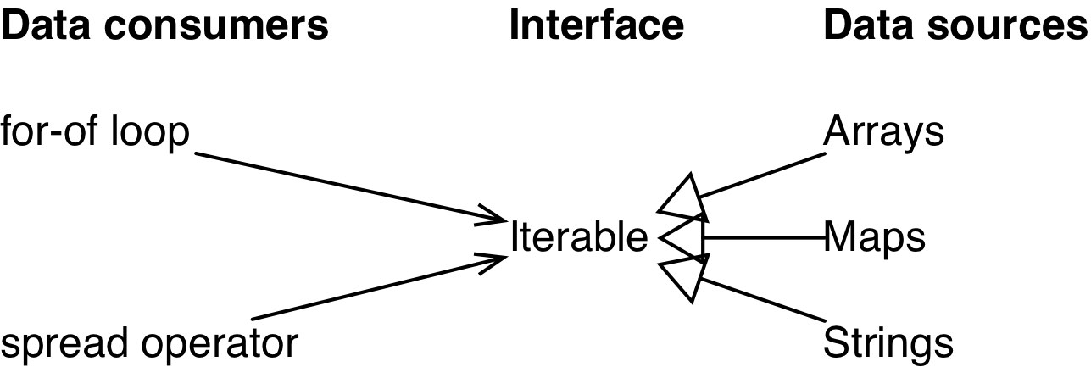
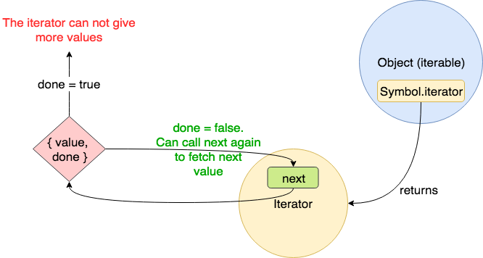
Iterator & For-Of Operator
ECMAScript 6
The for–in loop is for looping over object properties.
The for–of loop is for looping over data—like the values in an array.
Notes:
Existing iterable values
Arrays
Strings
Maps
Sets
DOM data structures (work in progress)

Slide 21
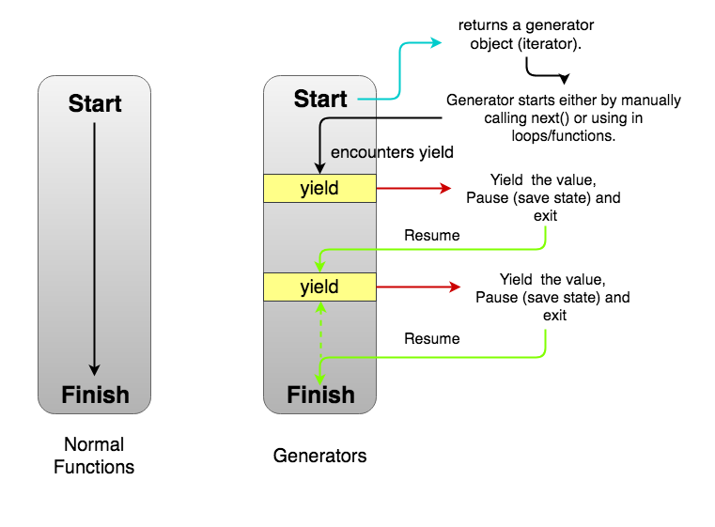
Generators
ECMAScript 6
Generator function is a form of iterator function that can stop midway and then continue from where it stopped

Slide 22
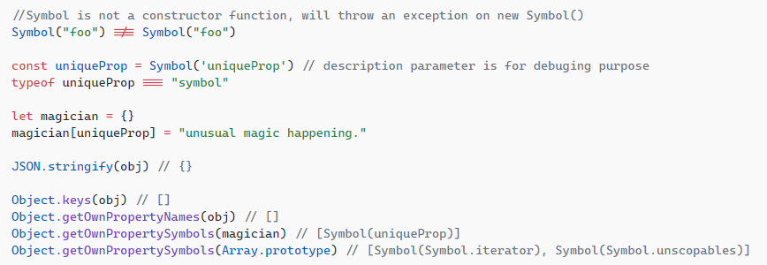
Symbols
ECMAScript 6
Unique and immutable data type to be used as an identifier for object properties. Symbol can have an optional description, but for debugging purposes only.
Symbol.for(key) - Searches for existing symbols with the given key and returns it if found. Otherwise a new symbol gets created in the global symbol registry with this key.
Symbol.keyFor(sym) - Retrieves a shared symbol key from the global symbol registry for the given symbol.
Notes:
The data type symbol is a primitive data type
Symbols are not enumerated, which means that they do not get included in a for..of or for..in loop ran upon an object.
Symbols are not part of the Object.keys() or Object.getOwnPropertyNames() result.

Slide 23
Modules & Module Loaders
ECMAScript 6
Module is essentially a reusable piece of JavaScript which exports specific objects, making them available for other modules to require in their programs.
Module Systems & Loaders
System
CommonJS
AMD
RequreJS
ES2015
UMD
Notes:
http://localhost:8000/es6/08-modules
https://www.typescriptlang.org/play/?target=2&module=4

Slide 24
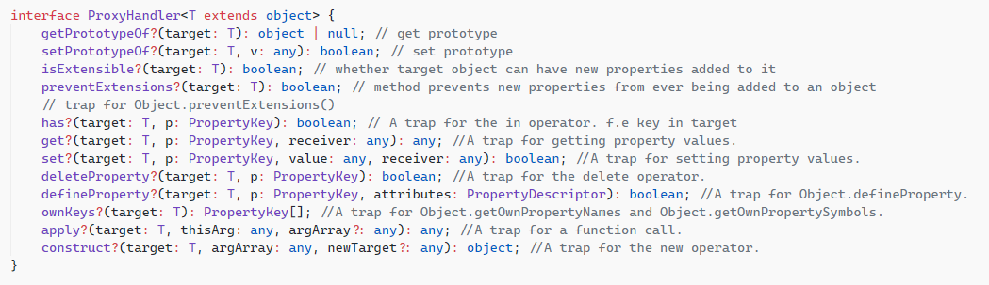
Proxy & Reflect
ECMAScript 6
The Proxy object is used to define custom behavior for fundamental operations (e.g. property lookup, assignment, enumeration, function invocation, etc).
var proxy = new Proxy(target, handler)
Reflect is a built-in object that provides methods for interceptable JavaScript operations. The methods are the same as those of proxy handlers. Reflect is not a function object, so it's not constructible.
Notes:
Proxy
declare type PropertyKey = string | number | symbol;
interface PropertyDescriptor {
configurable?: boolean;
enumerable?: boolean;
value?: any;
writable?: boolean;
get?(): any;
set?(v: any): void;
}
Reflect
f.apply(obj, args), f might be an object and has apply method. You might need to call Function.prototype.apply.call(f, obj, args) But instead you can Reflect.apply(f, obj, args)

Slide 25
New Built-In Methods
ECMAScript 6
Object Property Assignment - New function for assigning enumerable properties of one or more source objects onto a destination object.
let options = Object.assign(opts, defaults)
Array Element Finding - New function for finding an element/index in an array.
[1, 3, 4, 2].find(x => x > 3) // 4
[1, 3, 4, 2].findIndex(x => x > 3) // 2
String Repeating
"-".repeat(4) // ----
String Searching
"hello".startsWith("ello", 1) // true
"hello".endsWith("hell", 4) // true
"hello".includes("ell") // true
"hello".includes("ell", 1) // true
"hello".includes("ell", 2) // false

Slide 26
New Built-In Methods
ECMAScript 6
Number Type Checking – New functions for checking for non-numbers and finite numbers.
Number.isNaN(NaN) // true
Number.isFinite(123) // true
Number.isSafeInteger(42) // true
Number Comparison – Epsilon Constant
console.log(0.1 + 0.2 === 0.3) // false
console.log(Math.abs((0.1 + 0.2) - 0.3) < Number.EPSILON) // true
Number Truncation and Sign Determination
console.log(Math.trunc(42.7)) // 42
console.log(Math.sign(7)) // 1

Slide 27
Map & Set
ECMAScript 6
Map is a collection of keyed data items, just like an Object. But the main difference is that Map allows keys of any type.
let map = new Map() // creates the map.
map.set(key, value) // stores the value by the key.
map.get(key) // returns the value by the key, undefined if key doesn’t exist in map.
map.has(key) // returns true if the key exists, false otherwise.
map.delete(key) // removes the value by the key.
map.clear() // removes everything from the map.
map.size // returns the current element count.
A Set is a special type collection – “set of values” (without keys), where each value may occur only once.
new Set(iterable) // creates the set, and if an iterable object is provided,
//copies values from it into the set.
set.add(value) // adds a value, returns the set itself.
set.delete(value) // removes the value,
// returns true if value existed at the moment of the call, otherwise false.
set.has(value) // returns true if the value exists in the set, otherwise false.
set.clear() // removes everything from the set.
set.size // is the elements count.
Notes:
Map Keys unlike objects, are not converted to strings. Any type of key is possible.

Slide 28
WeakMap & WeakSet
ECMAScript 6
WeakMap is Map - like collection that allows only objects as keys and removes them together with associated value once they become inaccessible by other means.
WeakSet is Set - like collection that stores only objects and removes them once they become inaccessible by other means.
Both of them do not support methods and properties that refer to all keys or their count. Only individual operations are allowed.
WeakMap and WeakSet are used as “secondary” data structures in addition to the “main” object storage. Once the object is removed from the main storage, if it is only found as the key of WeakMap or in a WeakSet, it will be cleaned up automatically.
Notes:
Main use cases are
additional data storage.
caching

Slide 29
Arrow Functions (1)
ECMAScript 6
Arrow function or lambda expression in other languages, commonly being used wherever an anonymous function expression is required, for example as a callback function
let aggregateFunction = (curr, prev) => curr + prev;
Arguments handling - On classic functions duplicate parameters are allowed on non-strict mode and override the existing parameter, but arrow functions throw Syntax Error.
Duplicate parameter handling - On classic functions duplicate parameters are allowed on non-strict mode and override the existing parameter, but arrow functions throw Syntax Error.
Constructor Function - Regular JavaScript function can be called with the new keyword to build an object. Unlike regular functions, arrow functions can never be called with the new keyword because they do not have the [[Construct]] method. As such, the prototype property also does not exist for arrow functions.
Notes:
Constructor Function
When a regular JavaScript function is invoked with the new keyword, the function’s internal [[Construct]] method is called to create a new instance object and allocate memory.
After that, the function body is executed normally, mapping this to the newly created instance object.
Finally, the function implicitly returns this (the newly created instance object), except a different return value has been specified in the function definition.
In summary, here is a list of the nonexistent bindings in arrow functions:
arguments: List of arguments passed to the function when it is called
new.target: A reference to the function being called as a constructor with the new keyword
super: A reference to the prototype of the object to which the function belongs, provided it is defined as a concise object method
this: A reference to the invocation context object for the function

Slide 30
Arrow Functions (2)
ECMAScript 6
No separate this
In short, with arrow functions there are no binding of this.
Before arrow functions, every new function defined its own this value based on how the function was called:
A new object in the case of a constructor.
undefined in strict mode function calls.
The base object if the function was called as an "object method".
Invoked indirectly with a bound object, through call(), apply(), bind()
etc.

Slide 31
Promises
ECMAScript 6
The promise object represent the eventual completion (or failure) of an asynchronous operation and its resulting value
A promise is in one of these state.
PENDING
FULFILLED
REJECTED
Initial state, neither Fulfilled nor Rejected
Operation completed successfully without error
Operation failed and error details are provided
Promise.All([]) – Returns a single promise that resolves when all of the promises are resolved or reject if any rejected.
Promise.Race([]) – Returns a promise that fulfills or reject as soon as one of the given promise is fulfill or reject.

Slide 32
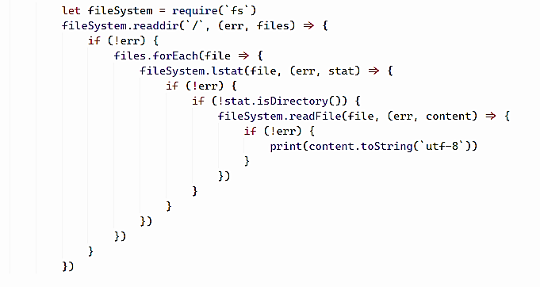

Promises
ECMAScript 6
Chaining
When a handler returns a value, it becomes the result of that promise, so the next .then is called with it.
A handler, used in .then(handler) may create and return a promise. In that case further handlers wait until it settles, and then get its result.
Compose – Promises solve a fundamental flaw with the callback pyramid of doom.

Slide 33
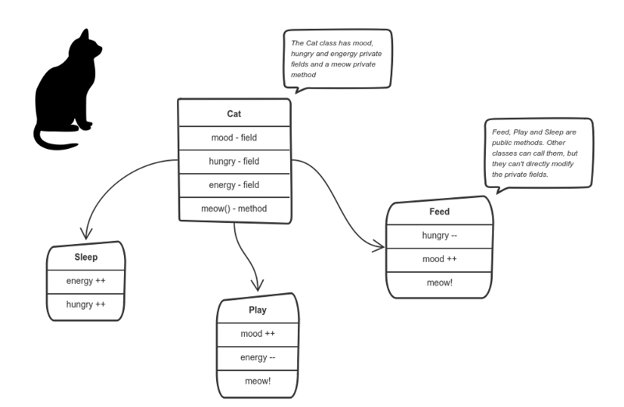
Object Oriented Programming

Slide 34
Object Oriented Programming
Object Oriented Programming
OOP is a programming paradigm based on the concept of `Objects`, which contain data, in form of fields(often known as attributes or properties), and code, in the form of functions (also known as methods)
ENCAPSULATION
INHERITANCE
POLYMORPHISM
ABSTRACTION

Slide 35
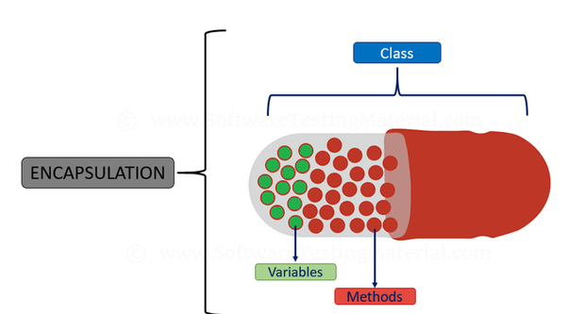
Encapsulation
Object Oriented Programming
Encapsulation is the idea that data is not directly exposed to the world. It’s about hiding as much as possible of the object’s internal parts and exposing a minimal public interface.
One of the biggest anomalies JavaScript is its inability to natively support encapsulation. But there are ways to achieve it.
Factory functions and closures – ES5
WeakMaps to associate data with object – ES6
Use of Symbols as member identifier. – ES6

Slide 36
Inheritance
Object Oriented Programming
Inheritance in most class-based object-oriented languages is a mechanism in which one object acquires all the properties and behaviors of another object.
In JavaScript, inheritance is supported by using prototype object. Some people call it "Prototypal Inheriatance" and some people call it "Behaviour Delegation".

Slide 37
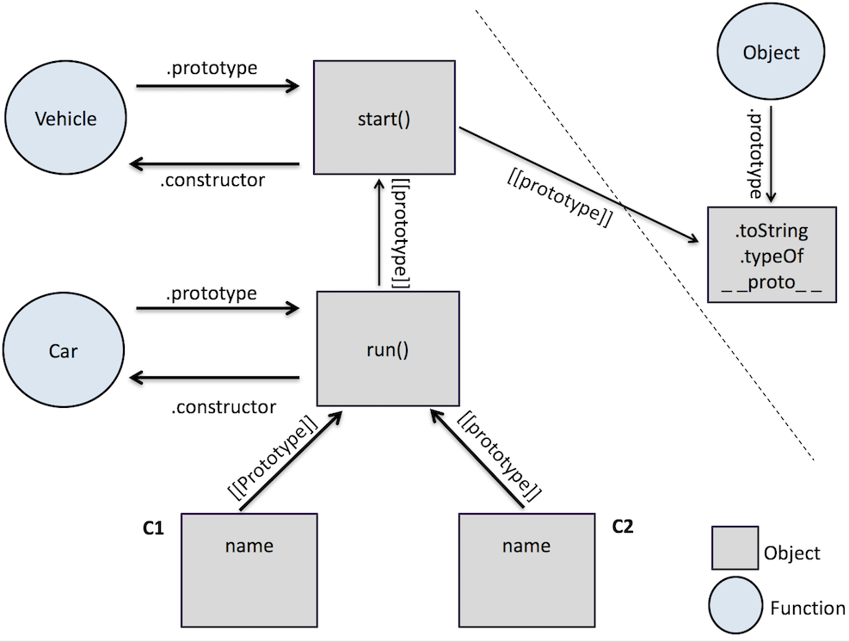
Prototype
Object Oriented Programming
Notes:
Define prototype
Define prototype chain

Slide 38
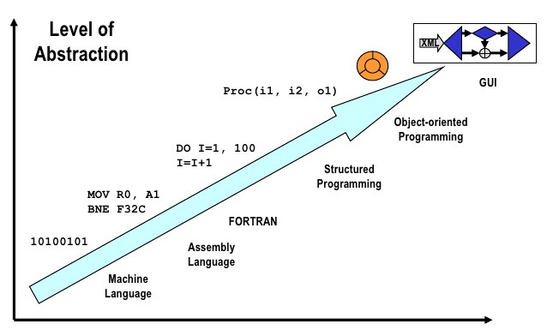
Abstraction
Object Oriented Programming
Abstraction manages complexity of a system by hiding internal details and composing it in several smaller systems.
Abstraction is to hide certain details and only show the essential features of the object.
Abstraction tries to reduce and factor out details so that the developer can focus on a few concepts at a time.
Notes:
Car usage is well known abstraction example
You don’t know what happening when you press the gas pedal. But it works.

Slide 39
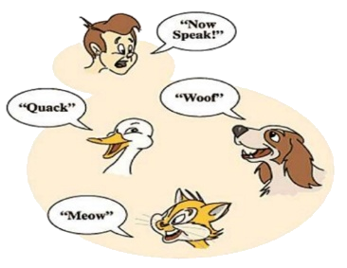
Polymorphism
Object Oriented Programming
Polymorphism in Object-Oriented Programming is the ability to create a variable, a function, or an object that has more than one form.
The primary usage of Polymorphism is the ability of objects belonging to different types to respond to methods, fields, or property calls of the same name, each one according to an appropriate type-specific behavior.

Slide 40
Habib AKCAKALE
Senior Software Engineer
habib.akcakale@osf-commerce.com

